Slide 1
Machine learning at Cooperstown
By: Prajit Ramaprasad and Kris King

Slide 2
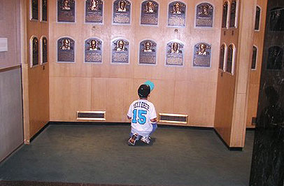
Purpose
In the sport driven by analytics, we wanted to use machine learning to sort through the mounds of player data compiled in the total history of the MLB to answer the question of what made a Hall of Famer and if we can predict the future of current players

Slide 3
Wrangling and Munging
We used the Lahman’s baseball SQL database to pull all baseball data from 1871 – 2016
From the SQL library we used the hitting data, fielding data, pitching data, and the Hall of Fame data tables
Since the data was in single season format, we used Pandas to sum up cumulative stats for all the players
We also created a Python application to scrape the career WAR for each player in our list from baseballreference.com
After that we created separate CSVs for hitters and pitchers to work from

Slide 4
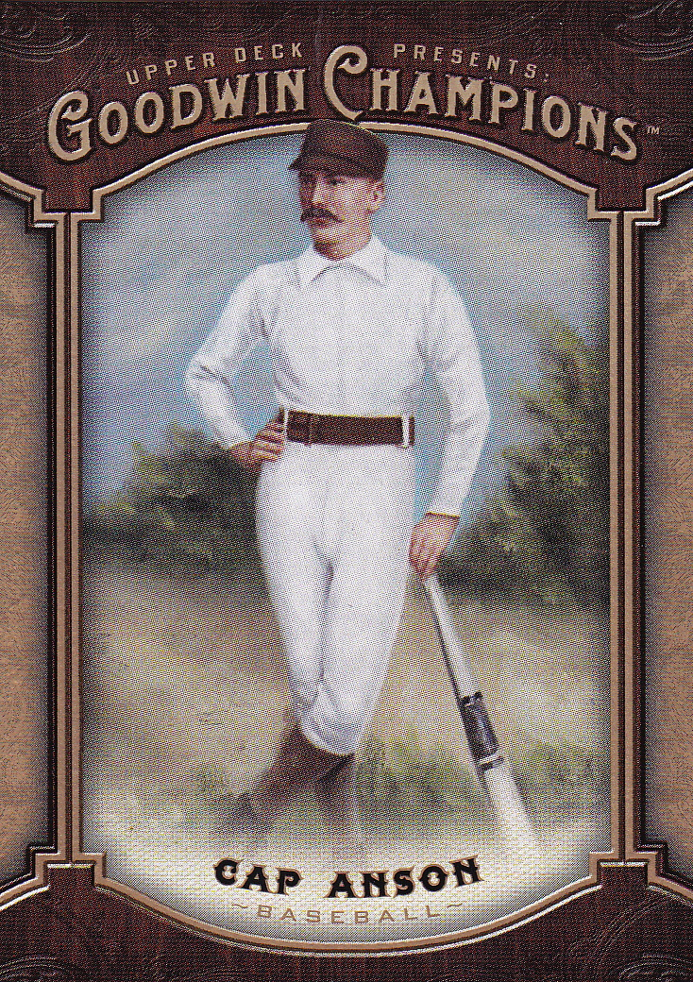
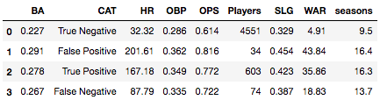
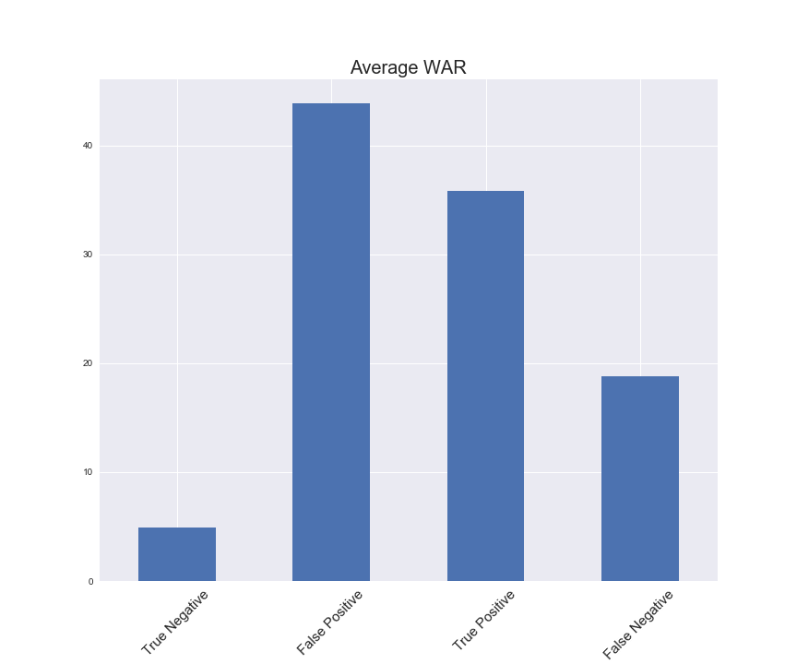
Testing for Hitters
Filtered using:
Slugging Percentage < .700
Batting Average < .400
Seasons Played > 4 & < 28
12035 / 680 to 4585 / 677
Data used for testing
Batting Average
On-Base Percentage
Slugging Percentage
WAR
Applied a Random Forest Classifier
Score of .91 from a 74/26 split (nonHOF/HOF)

Slide 5
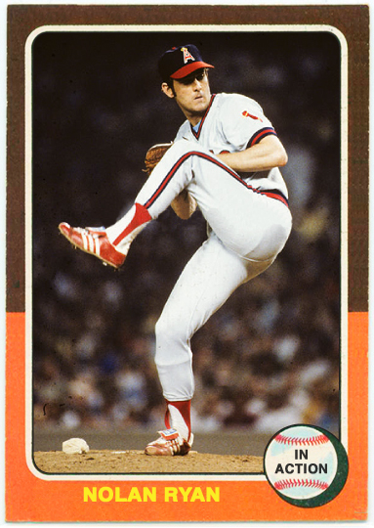
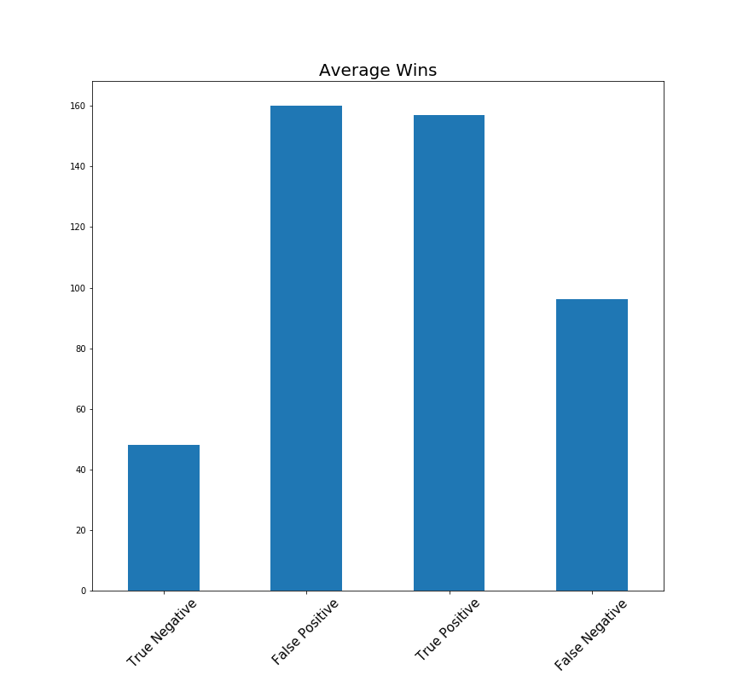
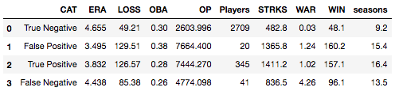
Testing for Pitchers
Filtered using:
Over 100 games
8852 / 449 to 2729 / 386
Data used for testing
ERA
Wins
Strikeouts
Games Played
Opposing Batting Average
We did not use any negative stats (losses/runs/walks)
Applied a Random Forest Classifier
Score of .92 from a 75/25 split (nonHOF/HOF)

Slide 6
Potential Issues and Next Steps
It is difficult to fully classify the data at this scale due to the variance in rules, playing style and talent levels across baseball eras
There are numerous intangible factors that can affect a player’s Hall of Fame chance. Aside from statistical references it is difficult to define the effects of leadership, off-field issues, gambling, steroids or even race
A next step to this project would be to use this model to graph current player’s career trajectory
Another application could be scaling the dataset to Minor League statistics and fitting the model for predictive success in the Majors

